Slide 1

NEXTHIKES PROJECT
User Analytics in the Telecommunication Industry - Overview

Slide 2
TELECOM INDUSTRY OVERVIEW
A telephone company^{[a]} is a kind of communications service provider (CSP), more precisely a telecommunications service provider (TSP), that provides telecommunications services such as telephony and data communications access. Many telephone companies were at one time government agencies or privately owned but state-regulated monopolies. The government agencies are often referred to, primarily in Europe, as PTTs (postal, telegraph and telephone services).^{[2]}
Telephone companies are common carriers, and in the United States are also called local exchange carriers. With the advent of mobile telephony, telephone companies now include wireless carriers, or mobile network operators.
Most telephone companies now also function as internet service providers (ISPs), and the distinction between a telephone company and an ISP may disappear completely over time, as the current trend for supplier convergence in the industry continues.^{[3]}
In the past, most TSPs were government owned and operated in most countries, due to the nature of capital expenditure involved in it. But today there are many private players in most regions of the world, and even most of the government owned companies have been privatized.

Slide 3
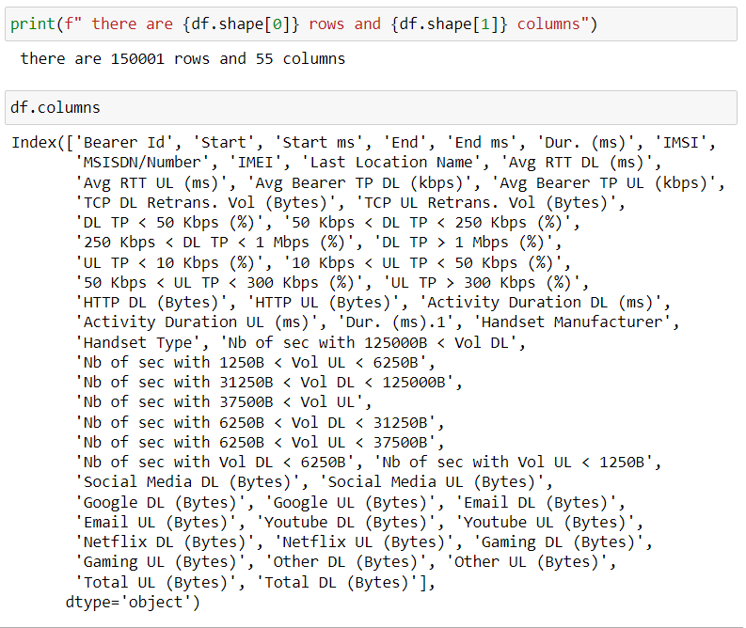
exploratory data analysis of telecom dataset

Slide 4
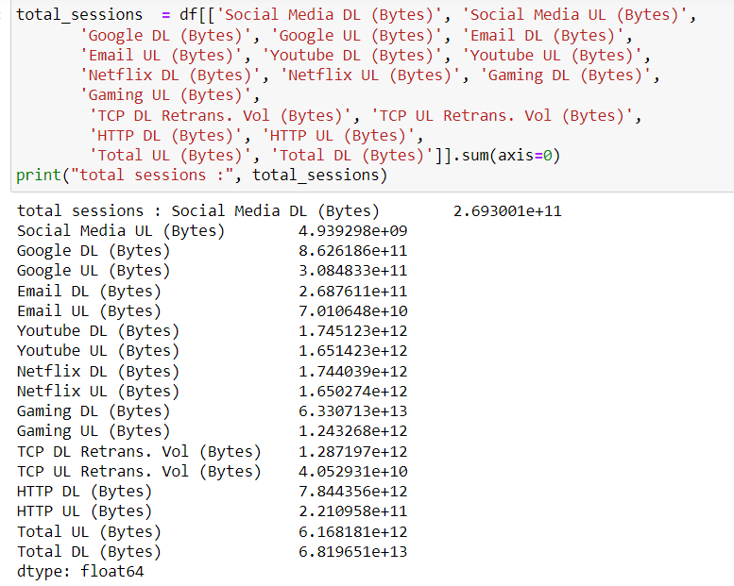
the session total traffic (download and upload (bytes)

Slide 5
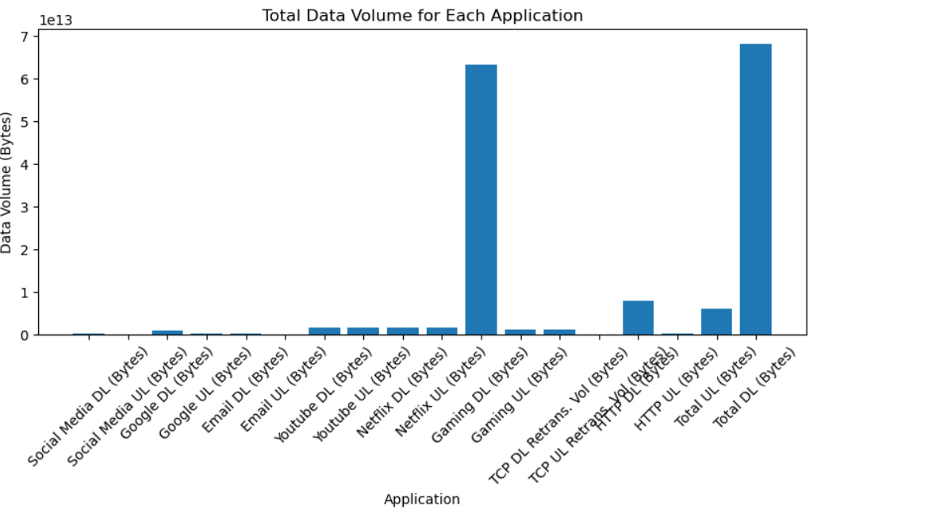
total data volume for each application

Slide 6
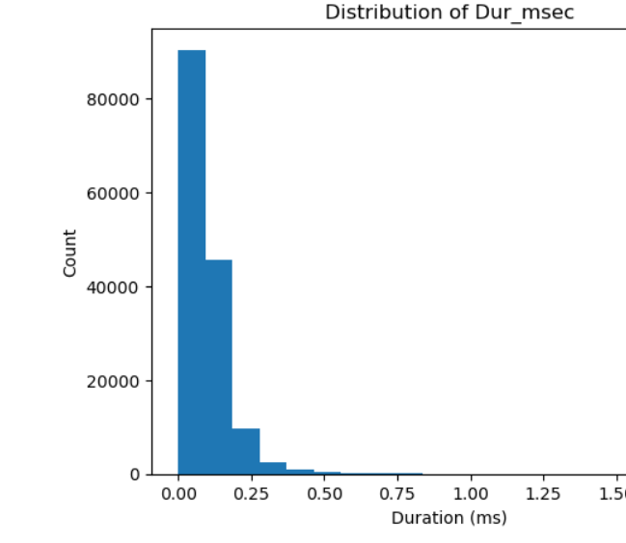
Distribution of duration

Slide 7
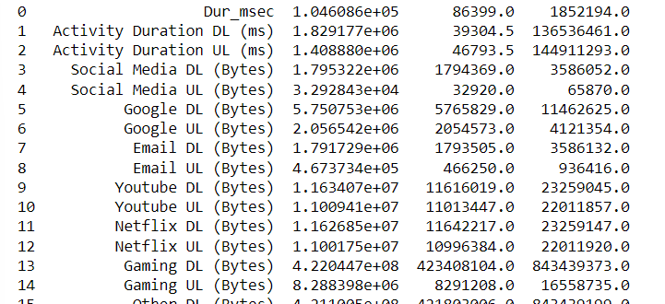
Univariate Analysis--- dispersion parameters for each quantitative variable:

Slide 8
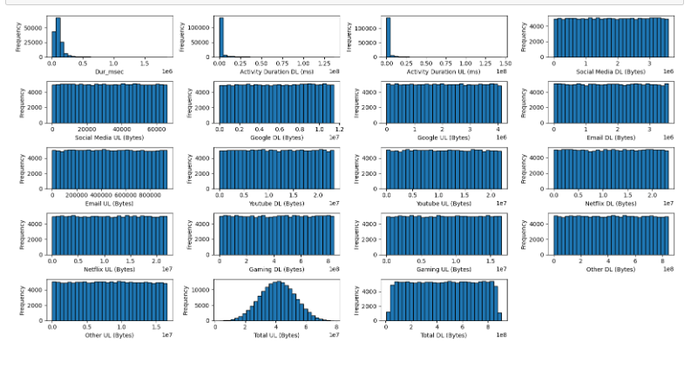
histograms for each quantitative variable¶

Slide 9
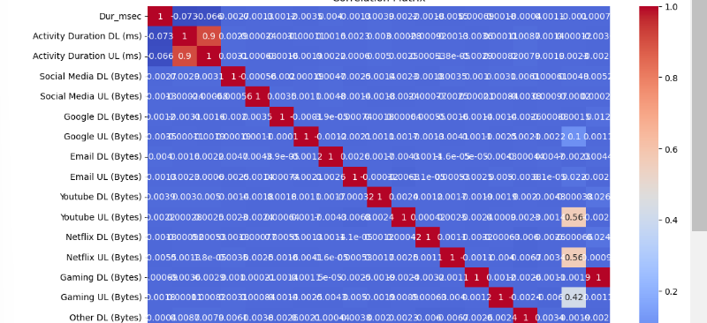
Bivariate Analysis---- correlation matrix as a heatmap

Slide 10
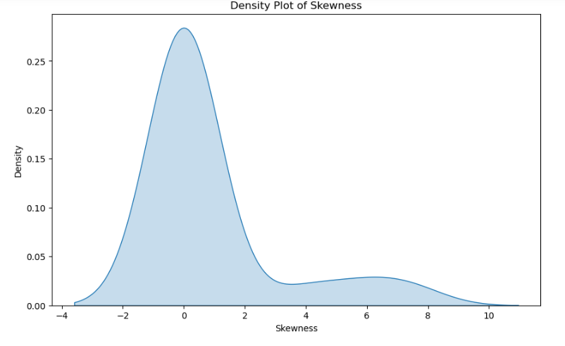
skewness of features

Slide 11
THANK YOU

